Slide 1
Probability Distributions
Shovan Bhowmik
Lecturer
Dept. of CSE, Baiust

Slide 2
Probability Mass Function(pmf)
The set of ordered pairs (x, f(x)) is a probability function or probability mass function, or probability distribution of the discrete random variable X if, for each possible outcome x,
1. f(x) ≥ 0,
2. = 1,
3. P (X = x) = f(x).
The probability distribution of a discrete random variable X is a list of the possible values of X together with their probabilities.

Slide 3
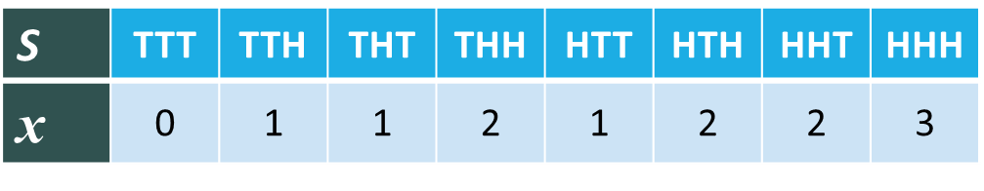
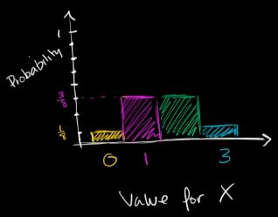
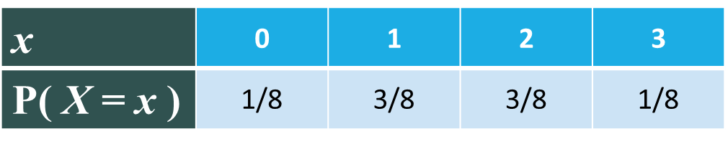
Probability Mass Function(pmf)(Cont..)
For Eg:
Consider an example of tossing 3 coins and counting the no. of heads
Let’s say, X is the random variable that represents the number of heads
The probability distribution is given below:

Slide 4


Probability Mass Function(pmf) - Example
A shipment of 20 similar laptop computers to a retail outlet contains 3 that are defective. If a school makes a random purchase of 2 of these computers, find the probability distribution for the number of defectives.
Solution: Let X be a random variable whose values x are the possible numbers of defective computers which are 0, 1, and 2.
The Probability distribution of X is:

Slide 5
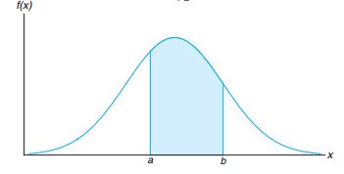
Probability Density Function(pdf)
The function f(x) is a probability density function (pdf) for the continuous random variable X, defined over the set of real numbers, if:
1. f(x) ≥ 0, for all x ∈ R
2.
3. P (a< X < b) =

Slide 6




Probability Density Function(pdf) – Example
Suppose that the error in the reaction temperature, in ◦C, for a controlled laboratory experiment is a continuous random variable X having the probability density function:
Verify that f(x) is a density function.
Find P(0 < X ≤ 1)
Solution:

Slide 7
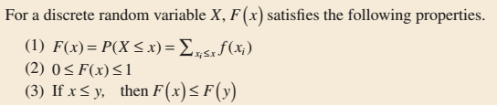
Cumulative Distribution Function(cdf)
It is denoted by F(x).
For coin toss example, the cdf is:

Slide 8
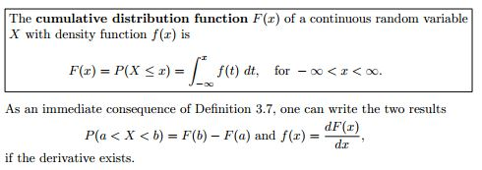
Cumulative Distribution Function(cdf)(Cont..)

Slide 9
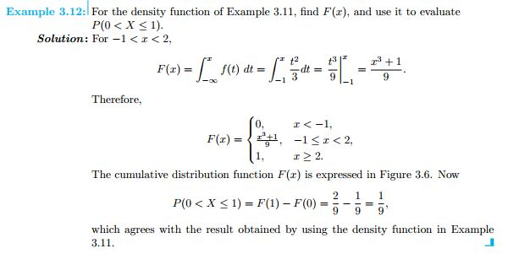
Cumulative Distribution Function(cdf)(Cont..)

Slide 10
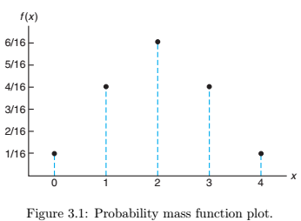
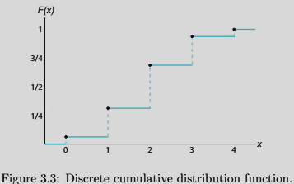
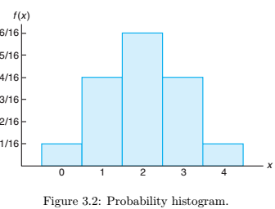
pmf/cdf – Graphic form(Discrete Case)

Slide 11
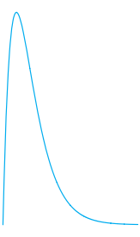

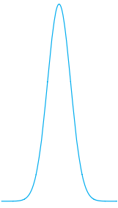
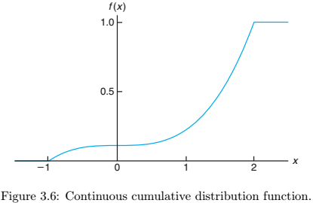
pdf/cdf – Graphic form(Continuous Case)
Typical density functions.

Slide 12
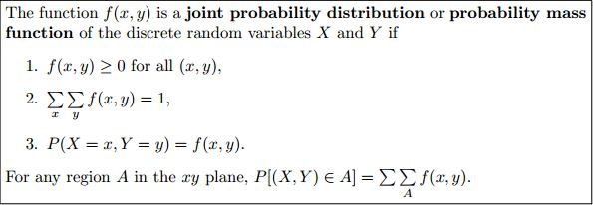
Joint Probability Distribution
If X and Y are two discrete random variables, the probability distribution for their simultaneous occurrence can be represented by a function with values f(x, y) for any pair of values (x, y) within the range of the random variables X and Y. It is customary to refer to this function as the joint probability distribution of X and Y.
Individual distributions of X and Y are then called the marginal distributions.

Slide 13
Joint Probability Distribution - Example
A program consists of two modules. The number of errors, X, in the first module and the number of errors, Y , in the second module have the joint distribution, P (0, 0) = P (0, 1) = P (1, 0) = 0.2, P (1, 1) = P (1, 2) = P (1, 3) = 0.1, P (0, 2) = P (0, 3) = 0.05. Find
the marginal distributions of X and Y
the probability of no errors in the first module
the distribution of the total number of errors in the program.

Slide 14
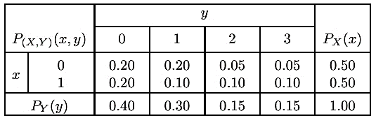

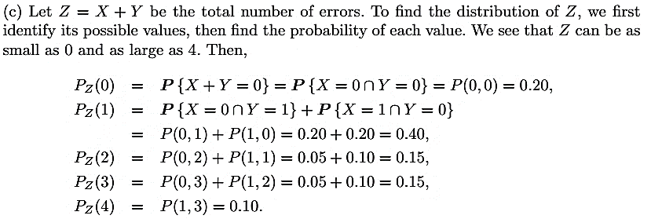

Joint Probability Distribution – Example(Cont..)
Solution:
$$\sum_{z}{\text{P}\text{z} }(Z)=1$$

Slide 15

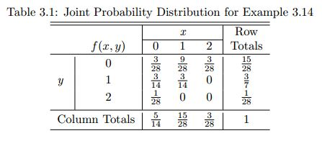

Joint Probability Distribution – Example(Cont..)
Two ballpoint pens are selected at random from a box that contains 3 blue pens, 2 red pens, and 3 green pens. If X is the number of blue pens selected and Y is the number of red pens selected, find
the joint probability function f(x, y)
P [(X, Y ) ∈ A], where A is the region {(x, y)|x + y ≤ 1}
Solution:
a)
The formula that will be used to find the probability distribution is:

Slide 16
Exercises
Walpole Book:
Example: 3.12, Exercise: 3.13, 3.14, 3.15, Example: 3.14, Exercise: 3.49. 3.50, 3.62, 3.74, Example: 4.1, 4.4, 4.6, Exercise: 4.10, 4.17, 4.19, 4.23, 4.32

Slide 17
References
Probability and Statistics for Engineers and Scientists(9th Edition) – Walpole

Slide 18


